Slide 1
Presentation of TED talk
Rohnie Baskar
April 6, 2017

Slide 2
The Single Biggest Reason why Startups Succeed
-Bill Gross

Slide 3
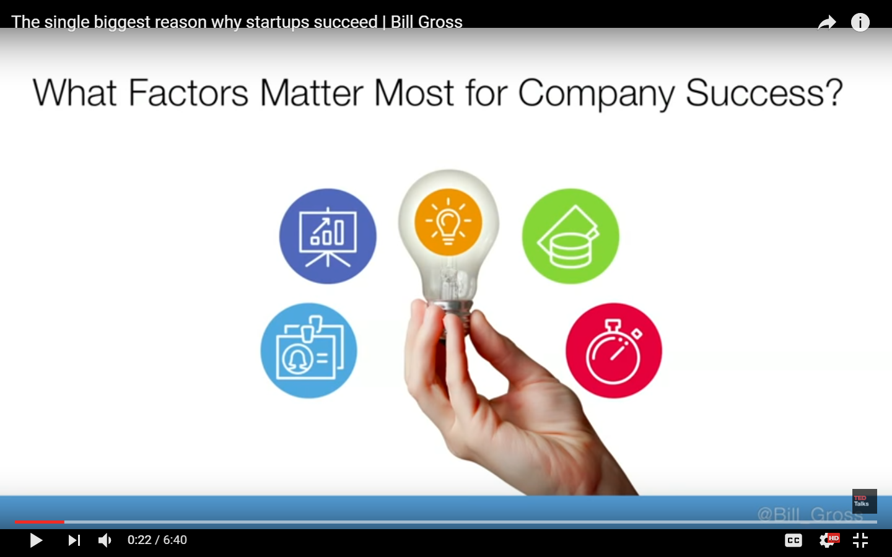

Slide 4


Slide 5
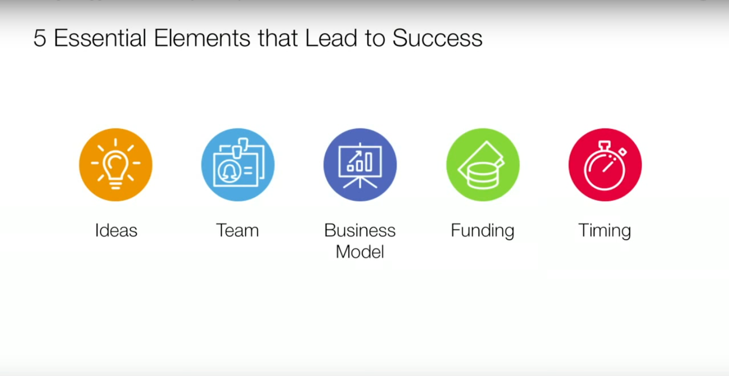

Slide 6
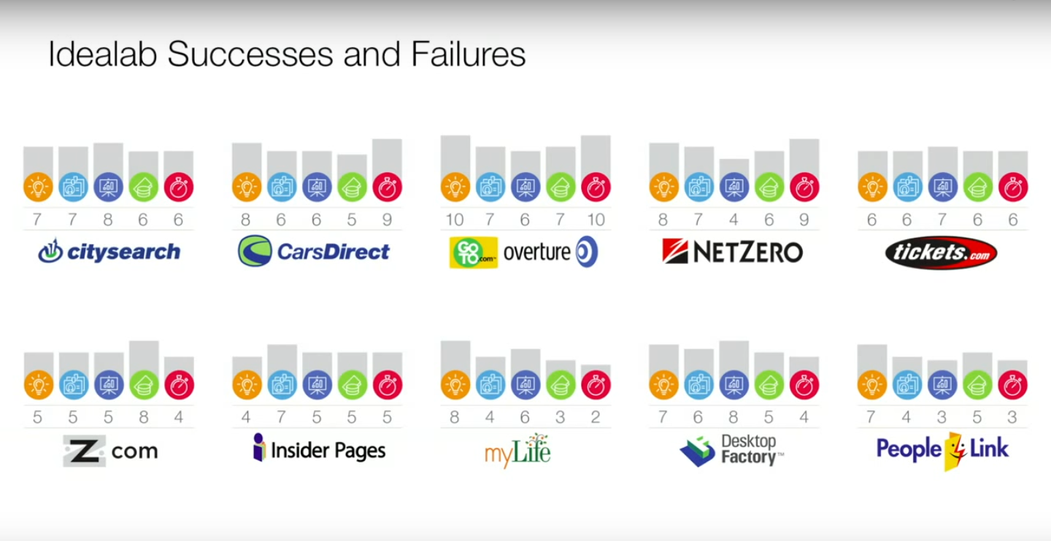

Slide 7
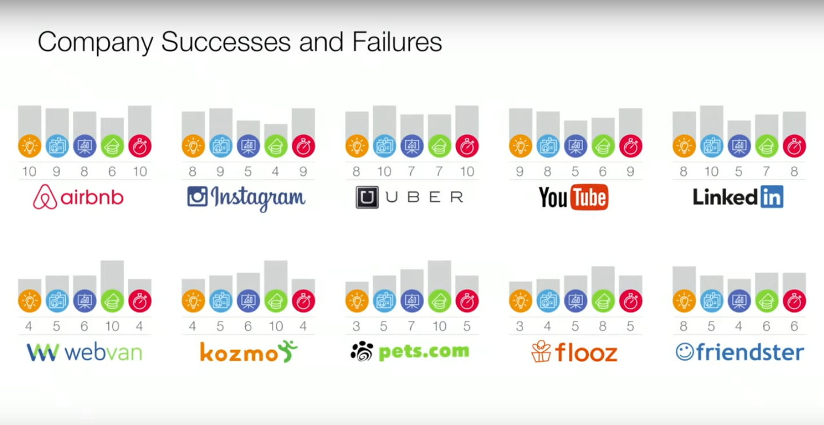

Slide 8
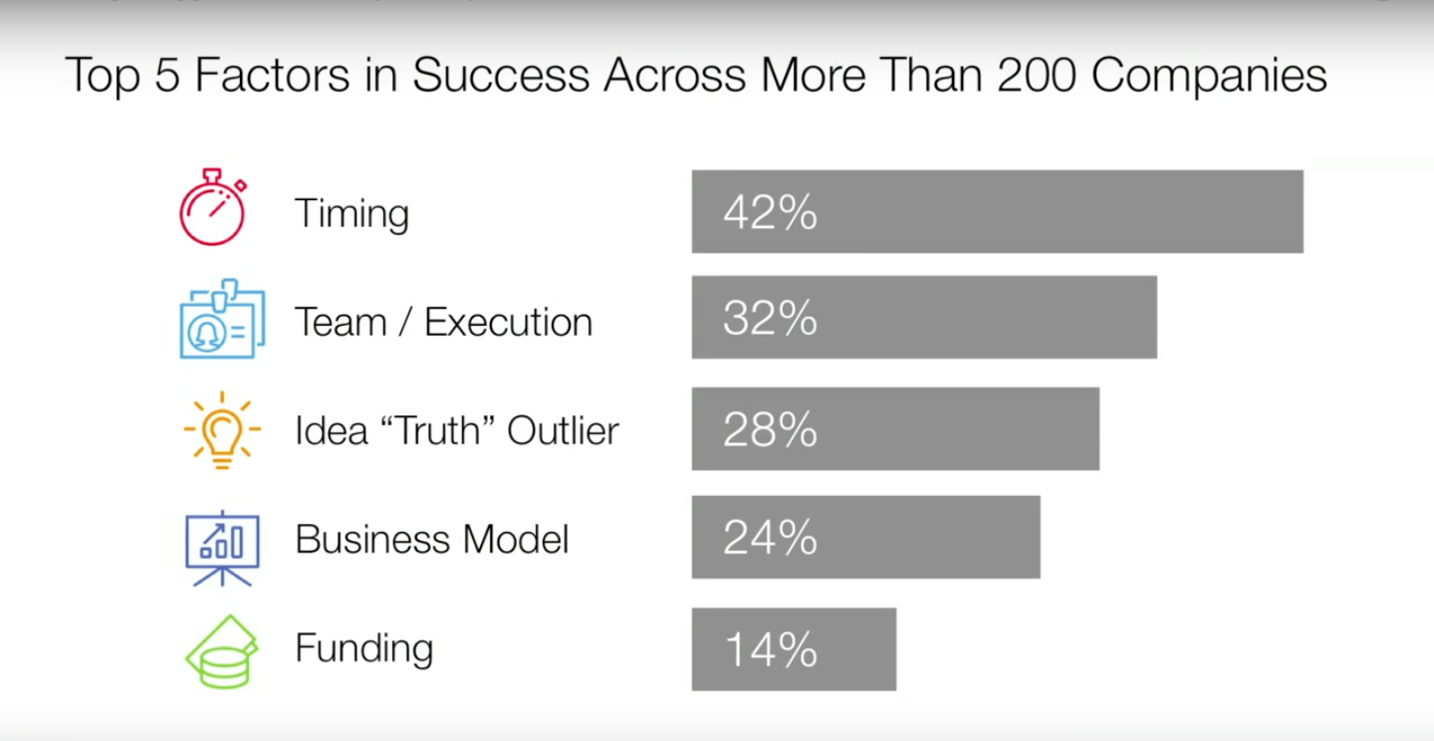

Slide 9
